Slide 1
Pizza Sales
SQL+ Azure Data factory+ Data Bricks+ Py-spark+ Power BI
Azure End to End Project

Slide 2
Business Requirement
We have data in on-premises SQL server and need to move into cloud storage.
We have to build pipeline to transfer and run data daily.
We need to connect our Azure storage account and connect it to Databricks,
Build an aggregate table for the reporting with all the Business related KPI, so the generated report can be used by stakeholder to take business decisions.
Build dashboard to show the visualizations of all the KPI’s using Power BI.

Slide 3
End to End Azure Design
SQL Server
Azure Data Factory Pipeline
Azure Storage account
Data Bricks
Aggregate table
Spark SQL
We have data(on-premise) on Sql server, now create ADF pipeline to move data from sql server to azure storage account. Once data is move to azure, we try to mount the storage account to data bricks with help of py -spark. Once we connected to data bricks with the help spark sql we will create a aggregate table and based on this table we will try to connect with the Power Bi to create visualization dashboard.
Power BI

Slide 4
Steps Followed:
Go to sql server and try to create a database and table and upload your csv file to the table.
Create Azure Storage account(used Blob storage and save the file format as CSV ), Data Factory and Data Bricks account.
Create pipeline in ADF to perform copy activity.
Create Integration runtime – when u want to move data from on-premises to cloud you need to create IR in ADF.
Create a linked service in ADF to connect with Sql server(on-premise) while creating the pipeline.
Load Data from Sql to Azure storage account with the help of data pipeline in ADF.
Connect Databricks to Storage using py-spark.
Build Databricks aggregate table using Spark Sql.
Connect Databricks to Power BI and generate visualization report.

Slide 5
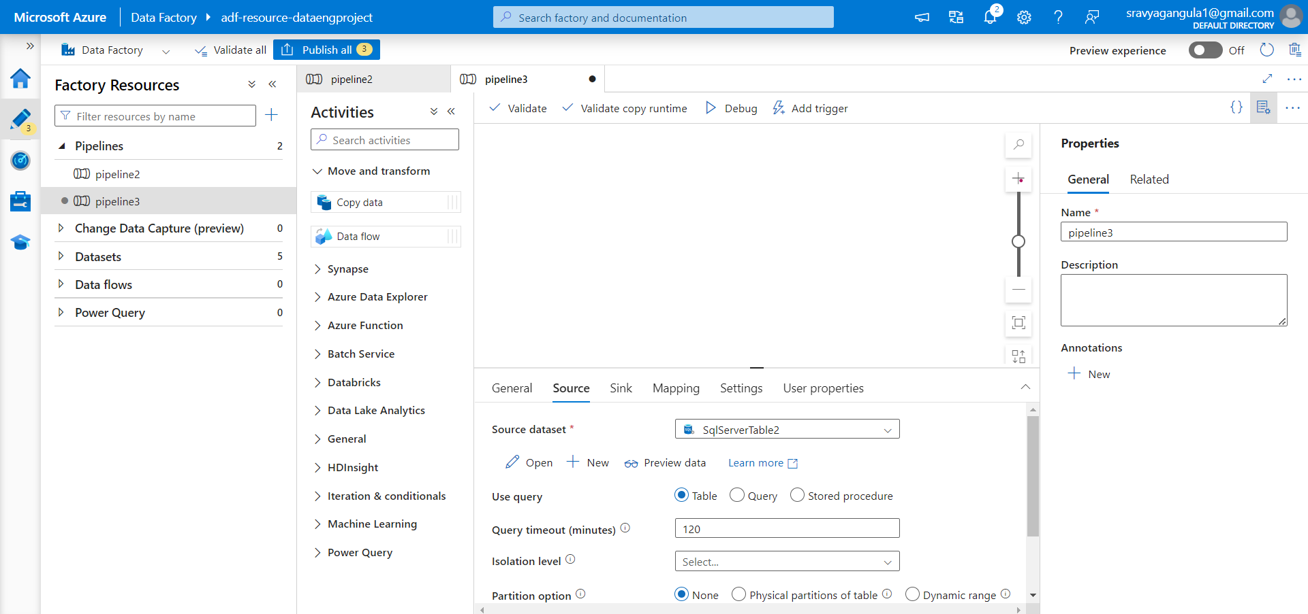
Source Creation

Slide 6
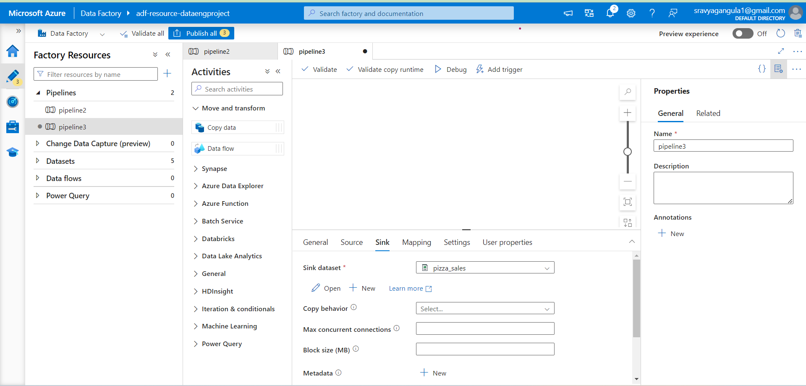
Sink

Slide 7
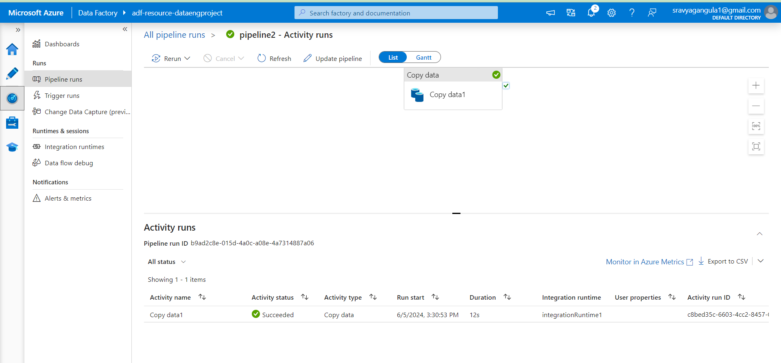
Pipeline Monitoring

Slide 8
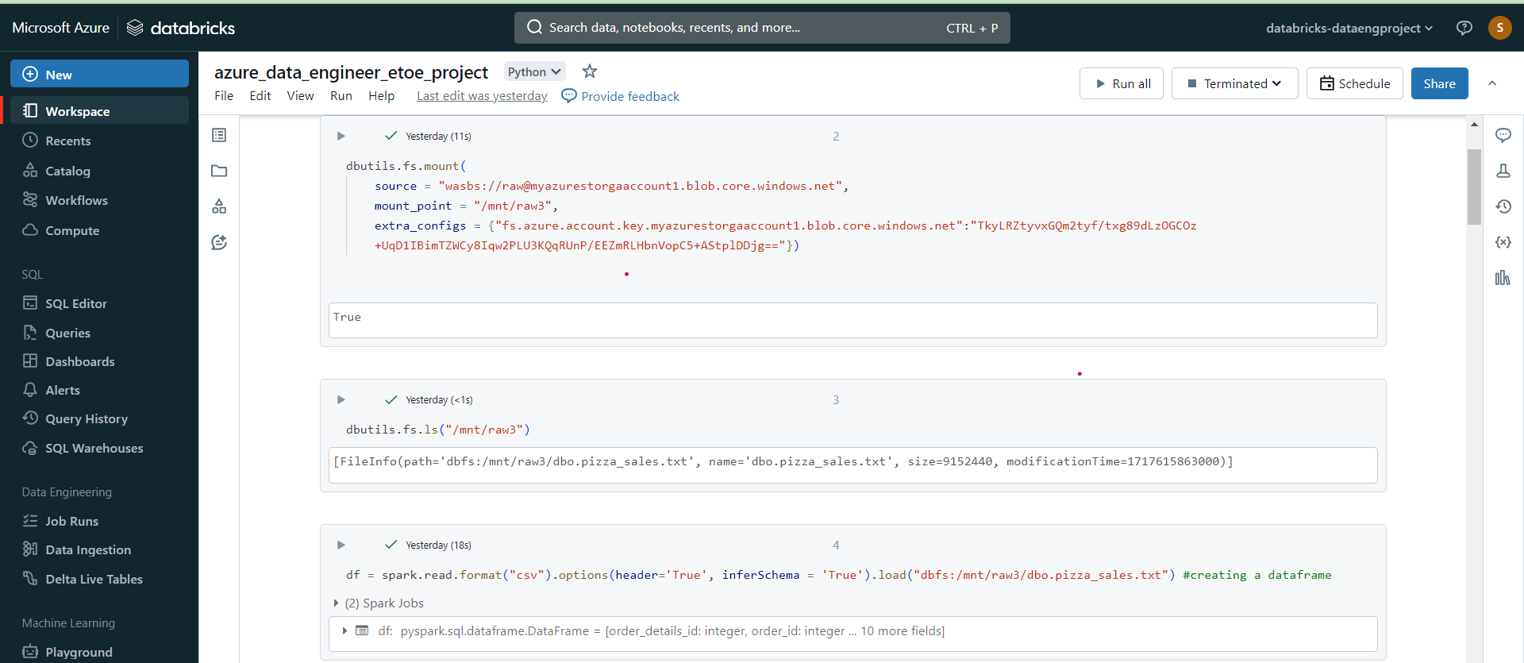
Mounting Data Bricks to Azure Storage Account

Slide 9
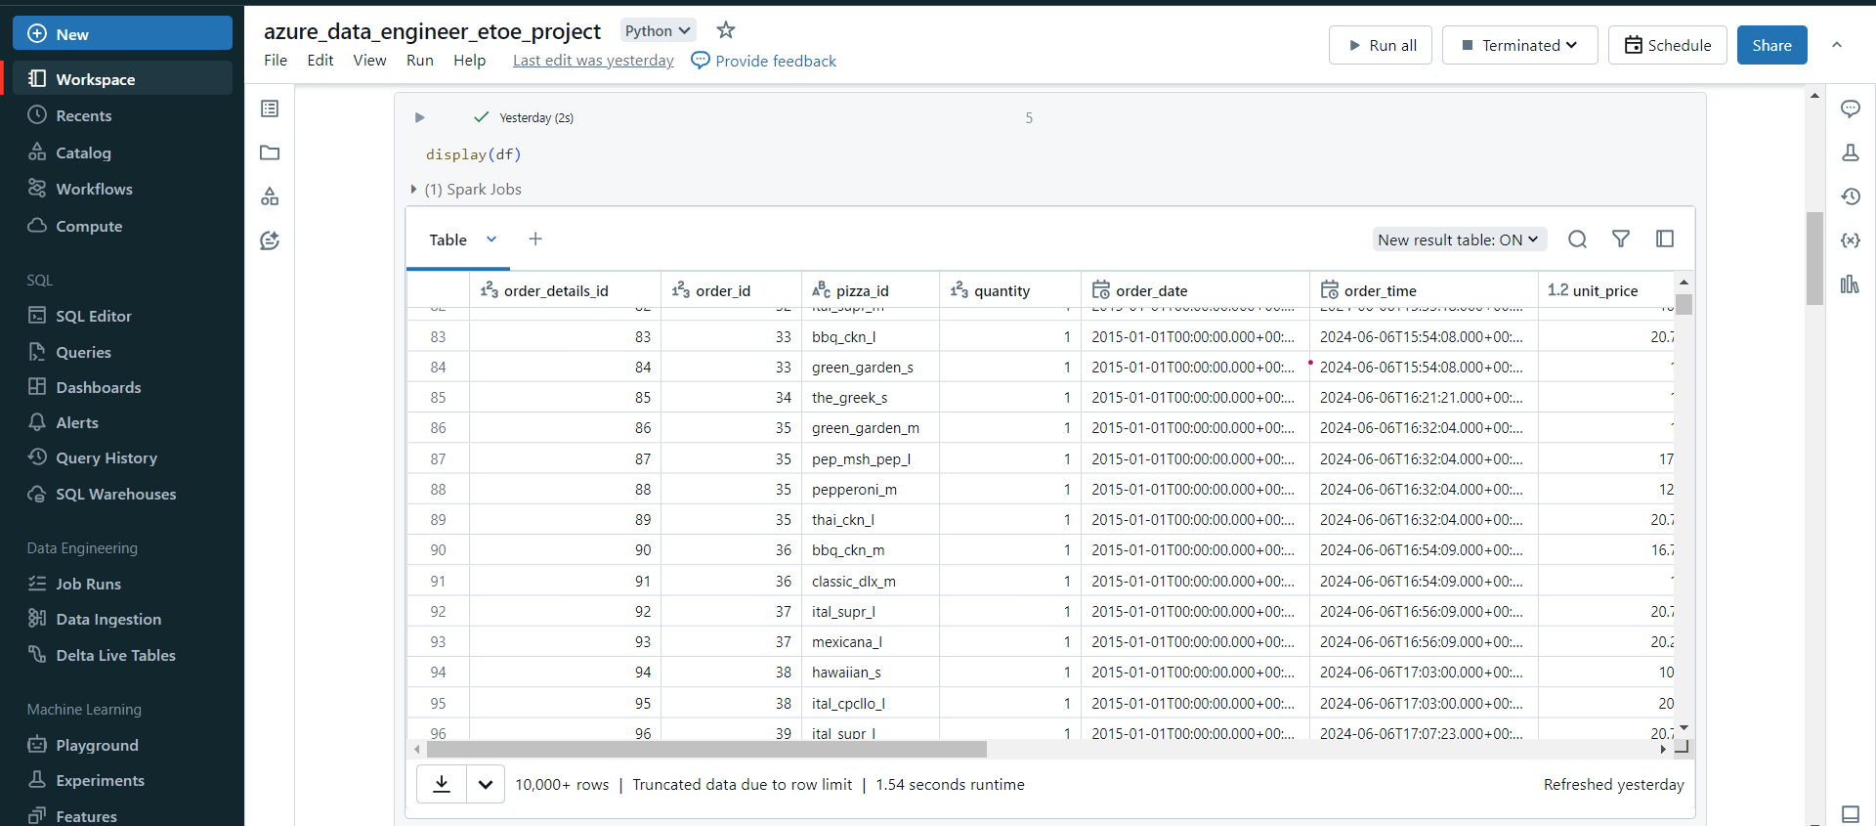

Slide 10
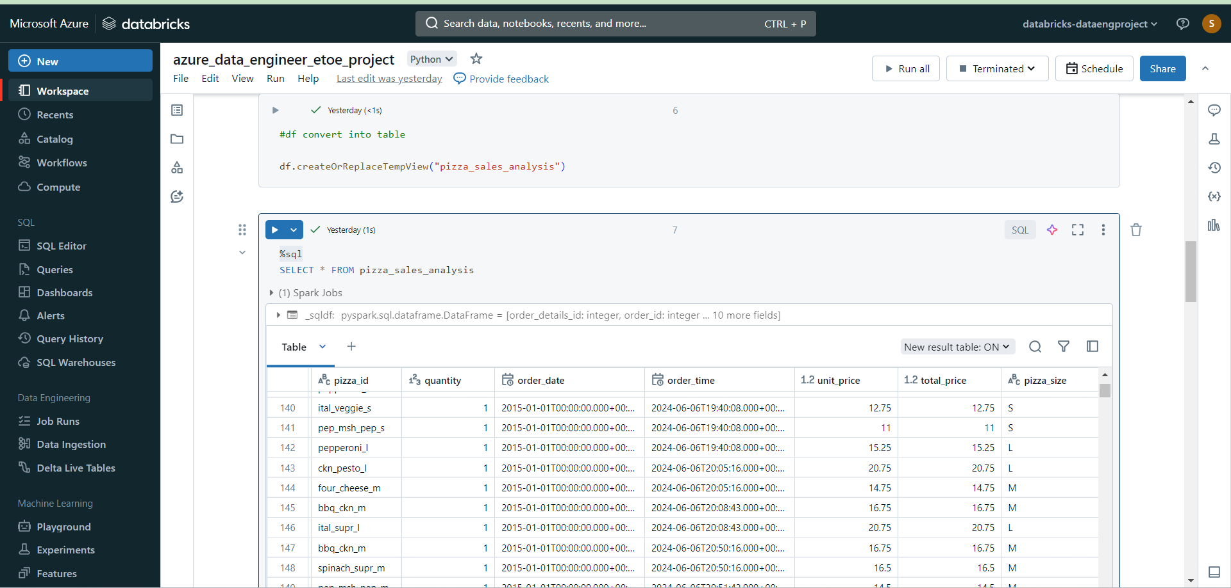

Slide 11
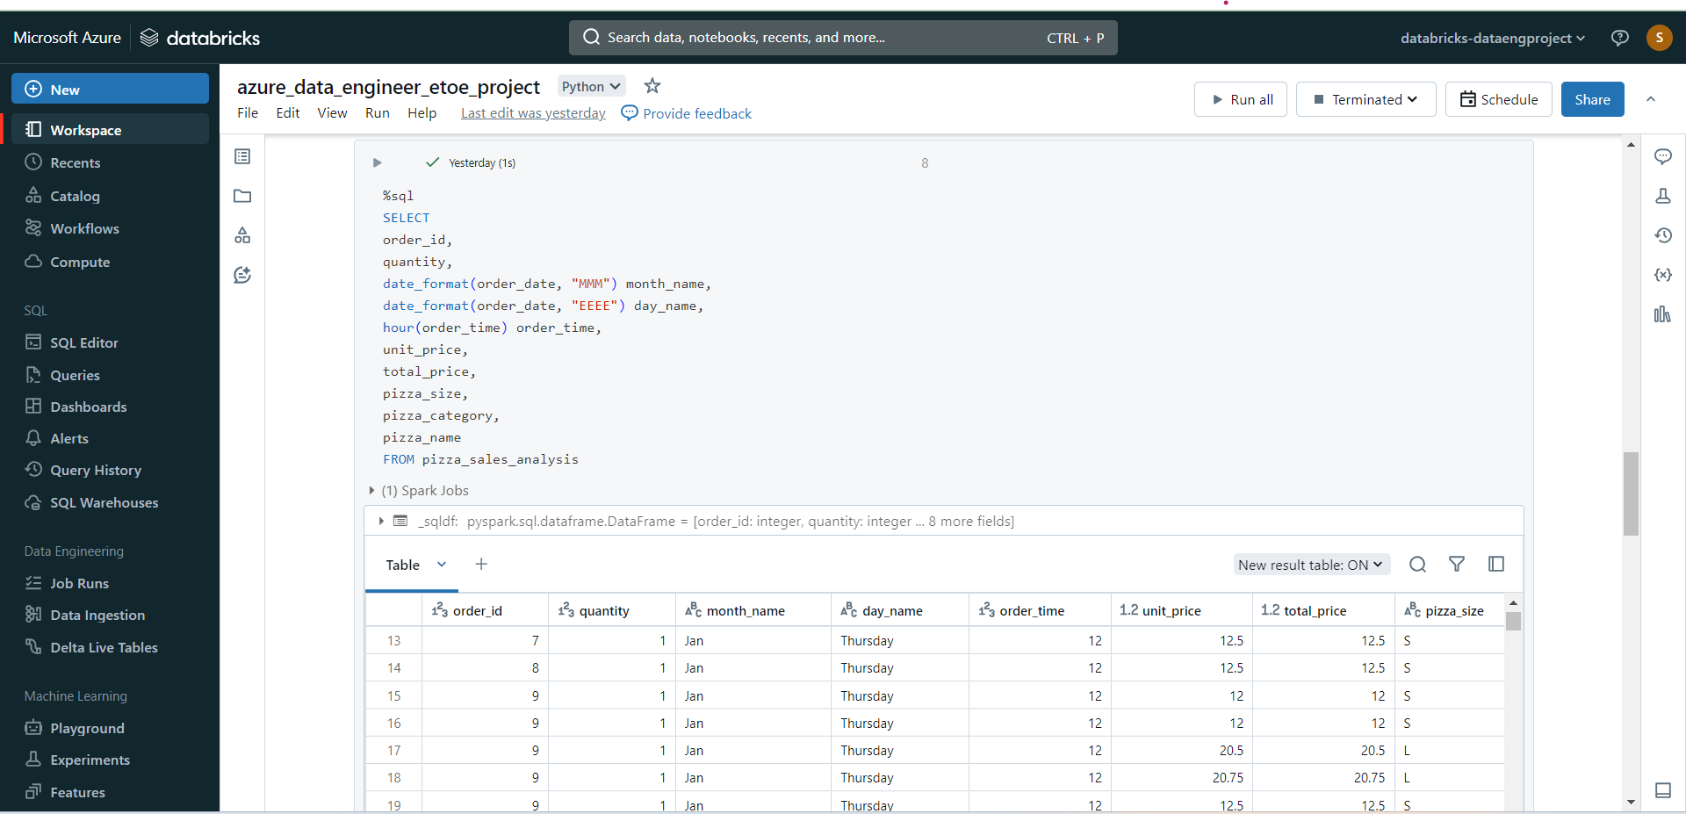

Slide 12
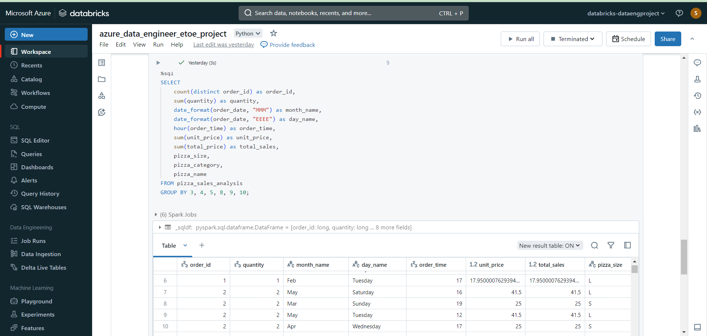

Slide 13
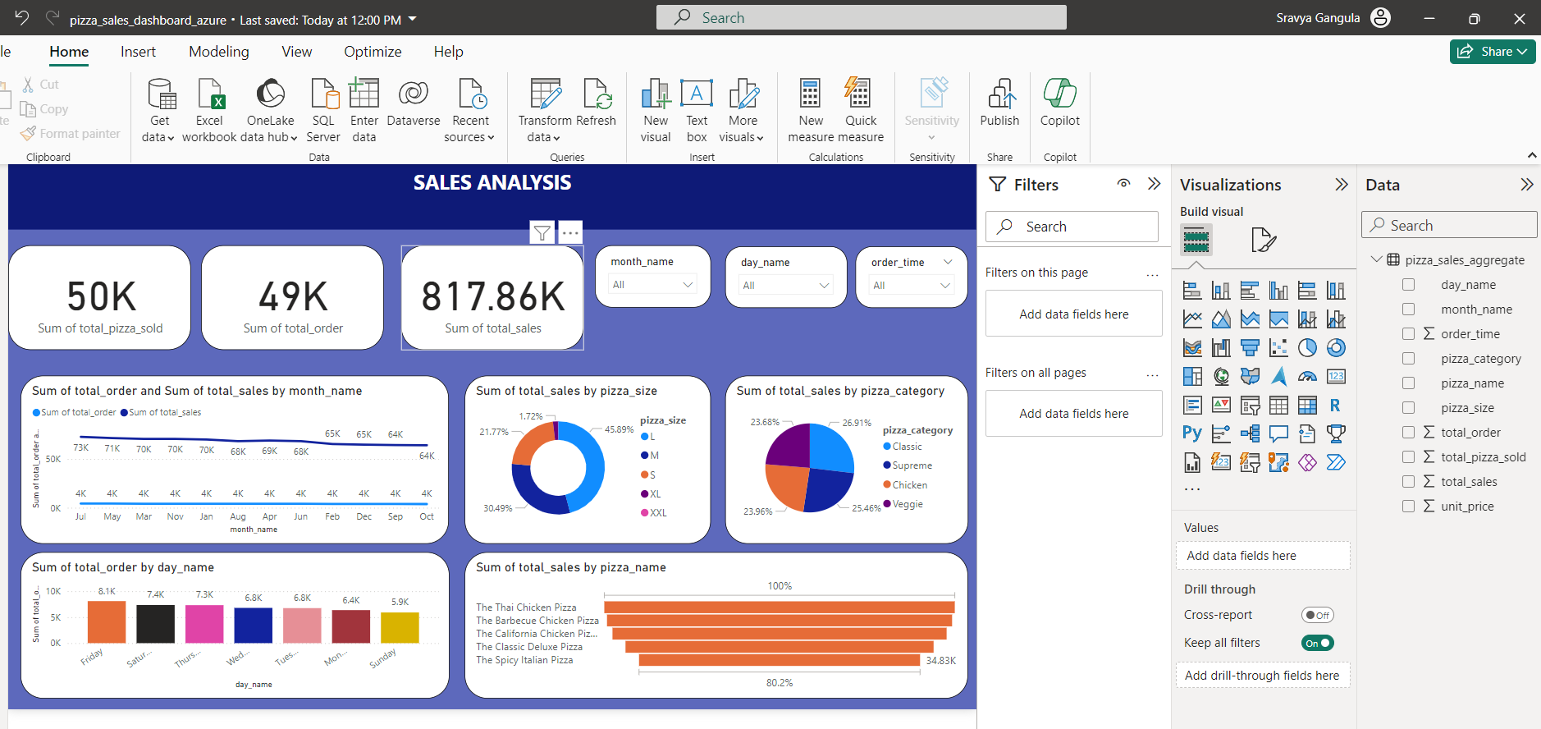
Pizza Sales Dashboard

Slide 14

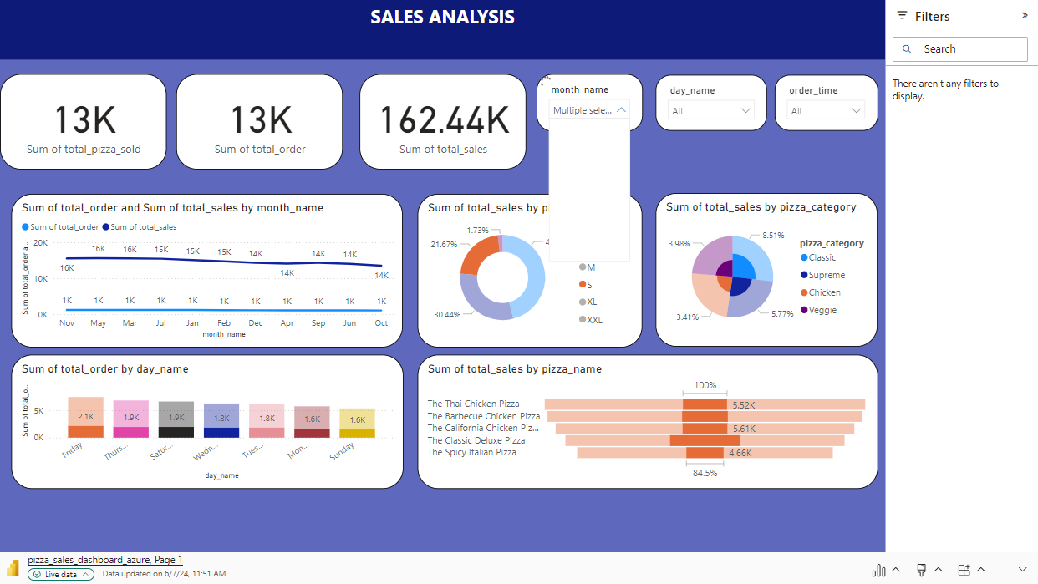
Microsoft Power BI

